Slide 1
50 FLIGHT
7
8
6
2 Dir Flt Ops
3
14 CAPCOM
15
5 O&P
9
19 RETRO
20 FIDO
45 COMP SUP
21 GUIDANCE
22
44 SPACE ENV
57 CONTROL
23 CCATS
24
25
26
27
58 TELCOM
28 TRACK
29
18 GNC
32 RECOVERY
33
34
35
17 EECOM
46 SPAN
12 SURGEON
13
59 EXPMT
53
47 BOOSTER
48
49
51 CONF LINE
52
54
55
56
16 INCO
11 Network
42
43

Slide 2
47 BOOSTER
19 RETRO
20 FIDO
21 GUIDANCE
48
49
22
12 SURGEON
14 CAPCOM
17 EECOM
18 GNC
58 TELCOM
57 CONTROL
45 COMP SUP
13
15
44 SPACE ENV
46 SPAN
16 INCO
5 O&P
6 AFD
50 FLIGHT
11 Network
28 TRACK
29
9
7
8
42
43
59 EXPMT
53
32 RECOVERY
33
34
35
2 Dir Flt Ops
3 MD
23 CCATS
24
25
26
27
51 CONF LINE
52
54
55
56

Slide 3
47 BOOSTER
19 RETRO
20 FIDO
21 GUIDANCE
48
49
22
12 SURGEON
14 CAPCOM
17 EECOM
18 GNC
58 TELCOM
57 CONTROL
13
15
16 INCO
5 O&P
6 AFD
50 FLIGHT
11 Network
9
7
8
42
43
2 Dir Flt Ops
3 MD
59 EXPMT
44 SPACE ENV
45 COMP SUP
46 SPAN
53 EASEP
28 TRACK
32 RECOVERY
23 CCATS
51 CONF LINE
29
33
34
35
24
25
26
27
52
54
55
56

Slide 4
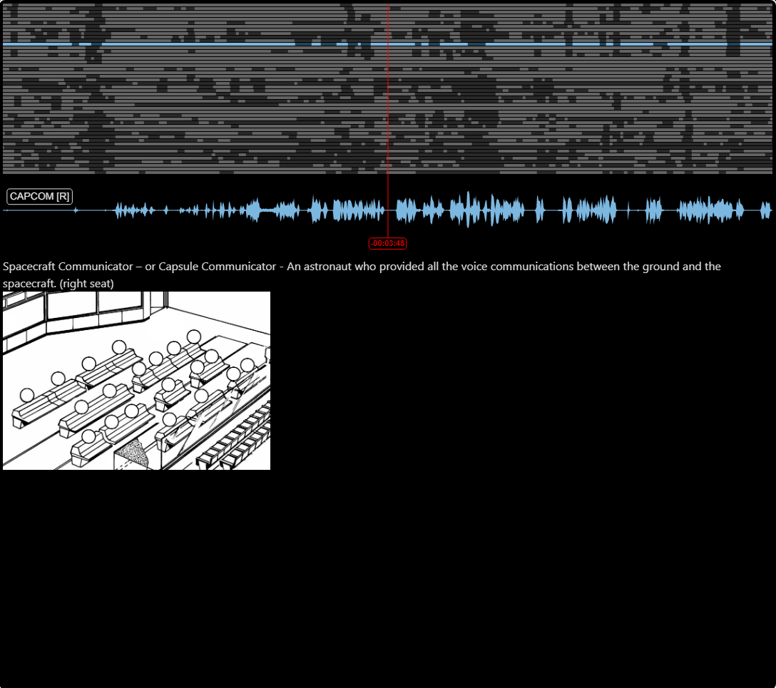
47 BOOSTER
19 RETRO
20 FIDO
21 GUIDANCE
48
49
22
12 SURGEON
14 CAPCOM
17 EECOM
18 GNC
58 TELCOM
57 CONTROL
13
15
16 INCO
5 O&P
6 AFD
50 FLIGHT
11 Network
9
7
8
42
43
2 Dir Flt Ops
3 MD
59 EXPMT
44 SPACE ENV
45 COMP SUP
46 SPAN
53 EASEP
28 TRACK
32 RECOVERY
23 CCATS
51 CONF LINE
29
33
34
35
24
25
26
27
52
54
55
56

